Slide 1
Self introduction
Isak Pao

Slide 2
About me
Name: Isak (pronouce as Isaac ) Pao
Experience: almot 15 years, mainly focused on web backend development.
Social media contact list: http://linktr.ee/windperson

Slide 3
At work
When at the startup called GranDen Inc., I was on Research & Developement team as a Chief Technology Officer.
We made some mobile app with the Augmented Reality, Emerging Cloud technology especially about Microsoft Azure.

Slide 4
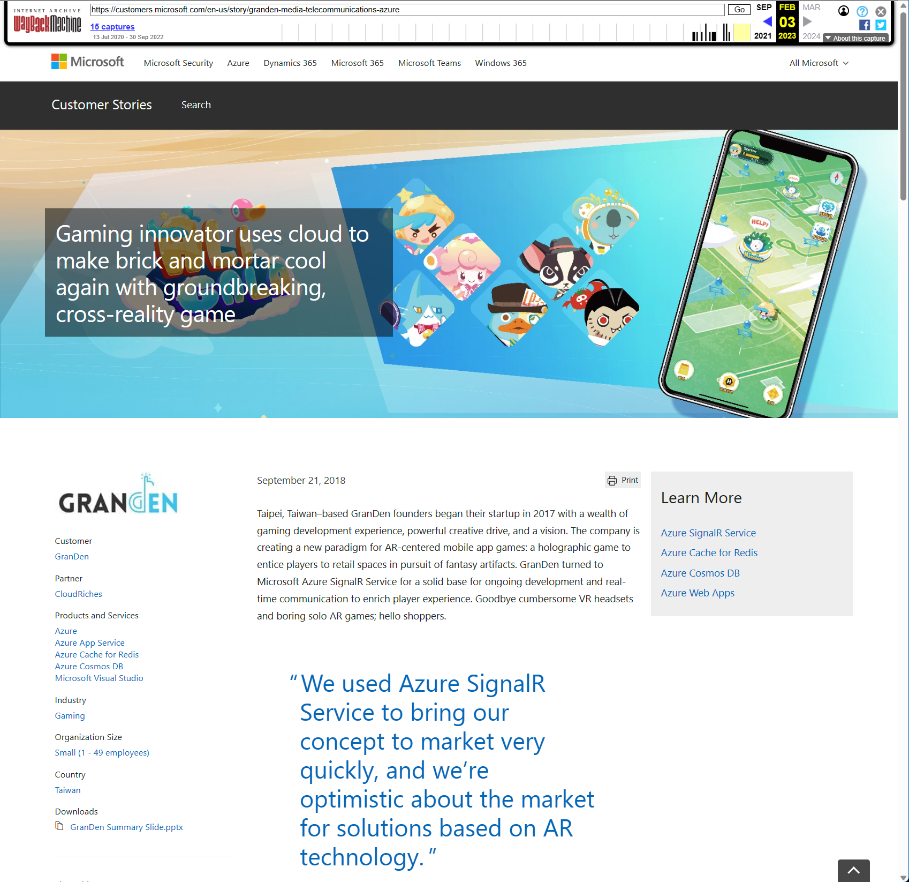
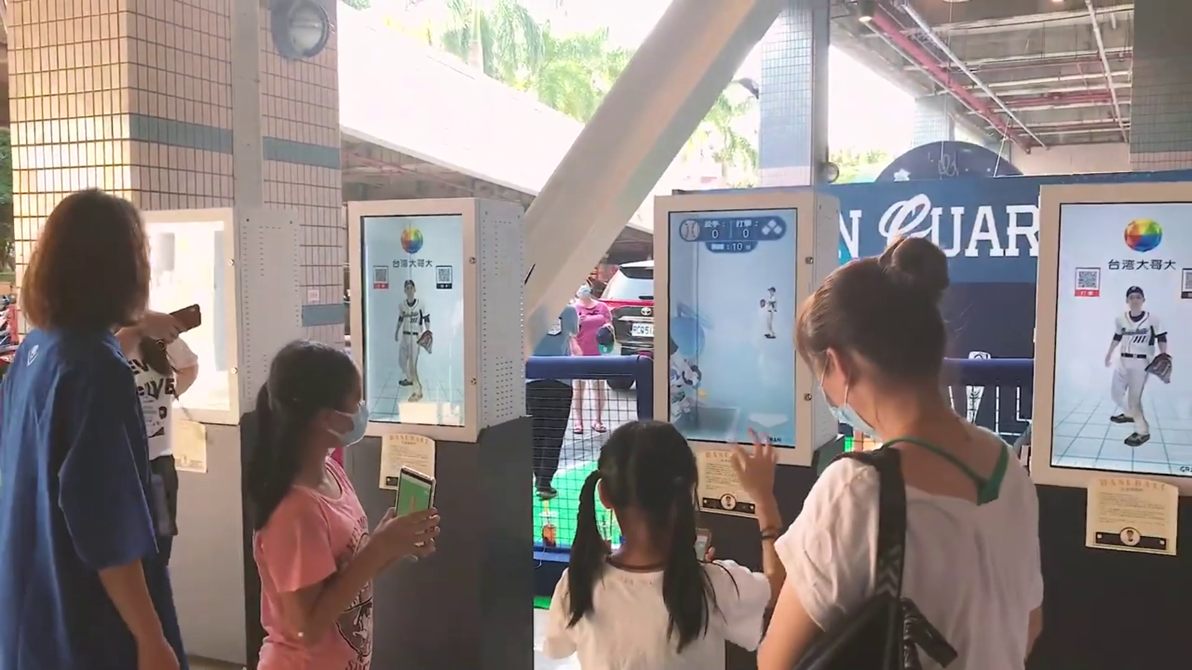
Microsoft Ignite 2018 Cusotmer Story
Interactive Baseball Game based on Azure SignalR service:
https://youtu.be/03rhzaQ38h4?si=TmMn3zMeU5JlwvwF

Slide 5
Tech community
Tech Summit speech:
Session speech in .NET Conf held in Taiwan by Study4TW from 2020 to 2023.
Cloud Summit 2022: Microsoft Orleans on Azure Cloud.
MonkeyFest 2018 Global Xamarin Bootcamp in Taipei & Xamarin China Summit 2019: topics about Xamarin app dev technology.
COSCUP 2017: gRPC communication between Java, Golang, .NET Core.
Container Summit 2016: Docker on game backend devops.
Manage the MR/XR Developers Community Facebook Group
Co-Host of the Mothly online streaming meetup of Facebook Group Xamarin Asia Developers

Slide 6
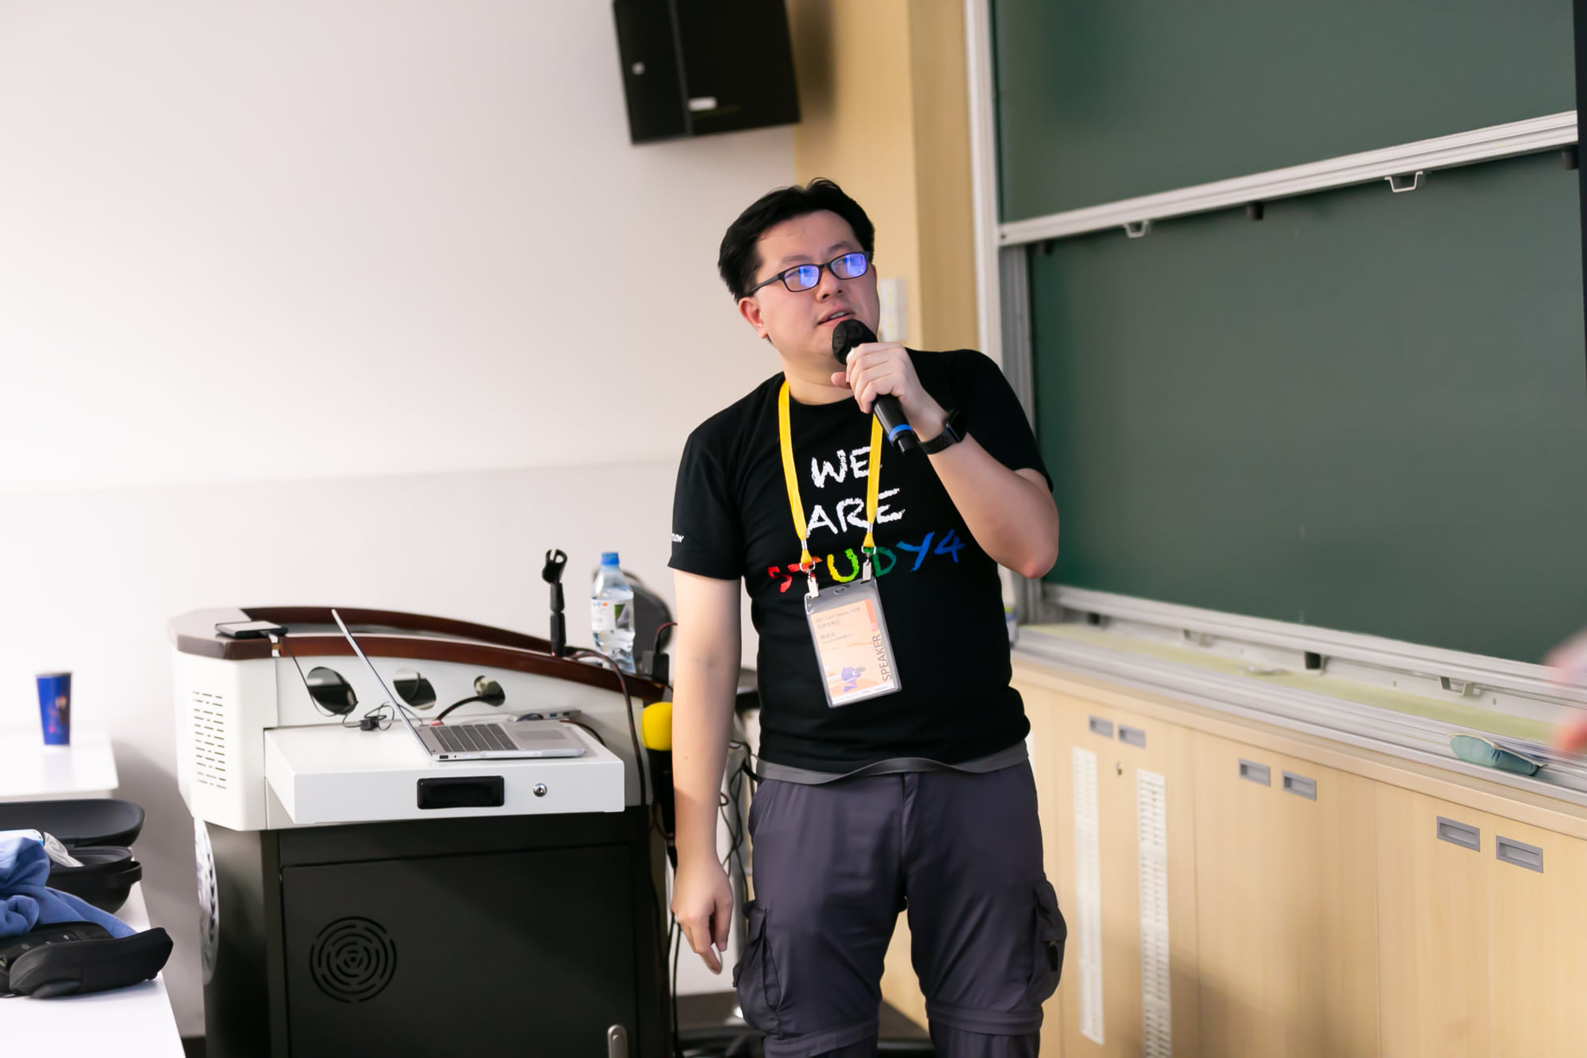
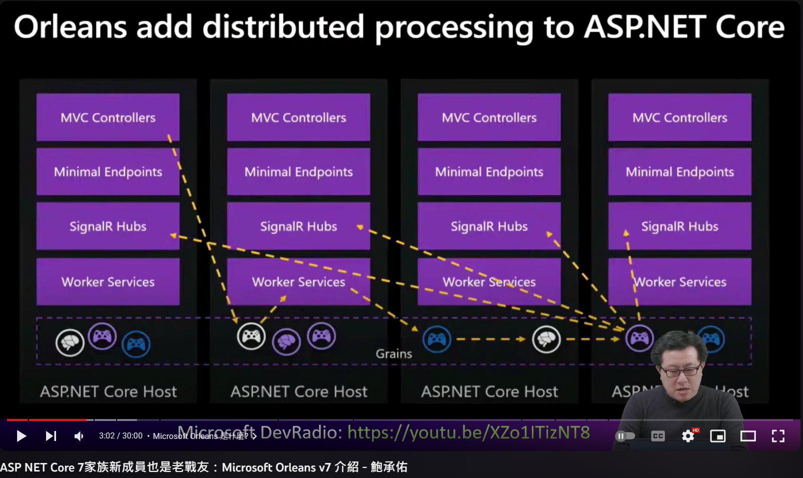
.NET Conf Taiwan 2020
.NET Conf Taiwan 2022 https://www.youtube.com/watch?v=oiJvbKReiTw

Slide 7
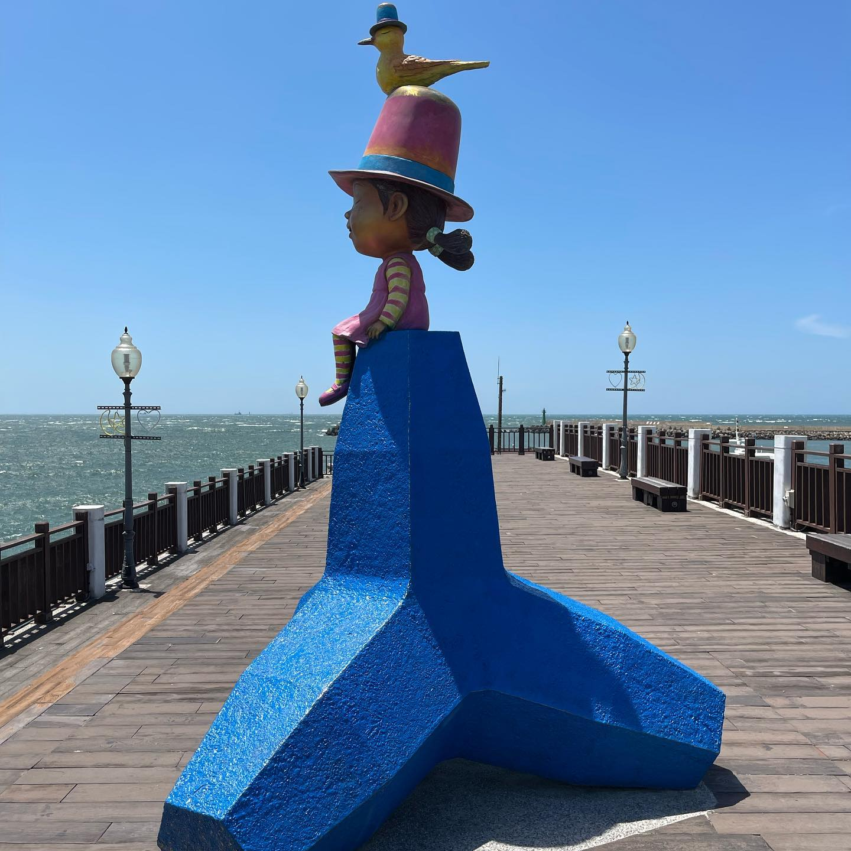
At Leisure
Recreation:
Reading (history, psychology), traveling, and finding intresting coffee shops.
Tamsui Fishrman Wharf

